Slide 1

Programs
How are programs developed, built, and executed?
"The amateur software engineer is always in search of magic." - Grady Booch

Slide 2

How programs are developed, built, stored, and executed
How to describe programming language levels (High/Low)
The C/C++ build process
How programs are executed

Slide 3
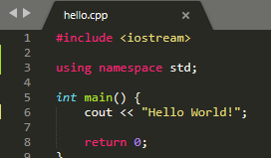
What is source code?
Text file that can be opened in any text editor
Collection of statements
Comments
Directives
Declarations
Executable Instructions

Slide 4
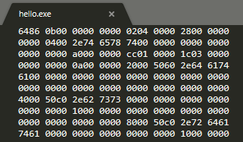
What is a program?
Compiled/Assembled instructions and data
Binary object code
CPU Architecture Family
Intel/AMD
ARM
MIPS
RISC
SPARC
IBM System 360/370/Z
VAX
Binary executable file

Slide 5
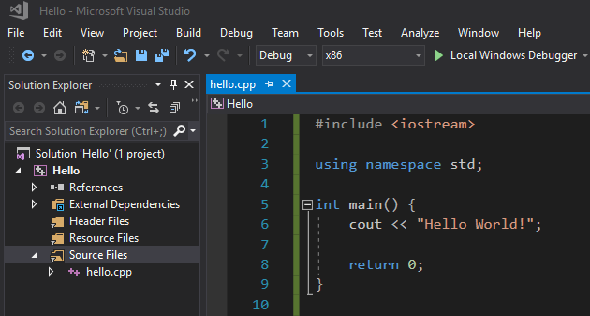
Where are programs developed?
Integrated Development Environment (IDE)
Source Code Editor
Build/Compiler Tools
Debug Tools
Source Code Repository
GIT
Subversion
CVS

Slide 6
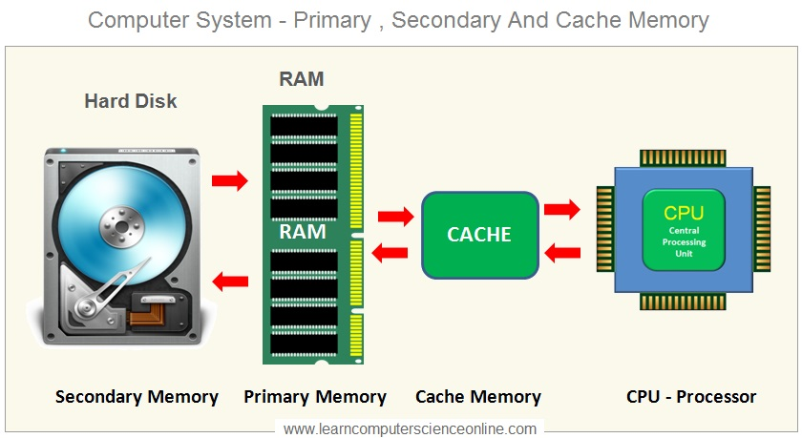
Where are programs stored?
Secondary Memory:
Source Code Files
Resource Files
Compiled Object Files
Executable File
Primary Memory:
Executable Object Code and Data
CPU Cache:
Instructions and Data

Slide 7
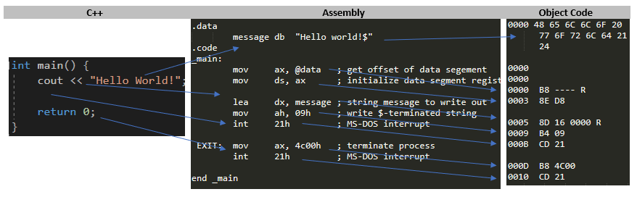
What are program language levels?
High Level – Instructions break down into multiple object code instructions
C/C++
Java
Low Level – Instructions map one-to-one to object code instructions
Assembly Language
Lowest Level – Each instruction is executable in the CPU
Machine Code
Interpretive Language – Instructions are mapped to executable instructions at runtime (no compiling)
Python
JavaScript

Slide 8
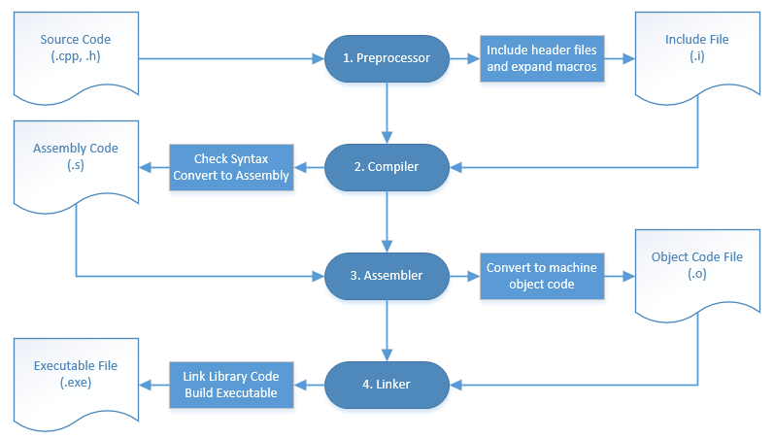
How are programs built?
C/C++ Build Process:
Pre-parse and include text Header files
Compile/Assemble text Source Code files
Link with libraries and create binary Object Code files
Create Executable binary object code file

Slide 9
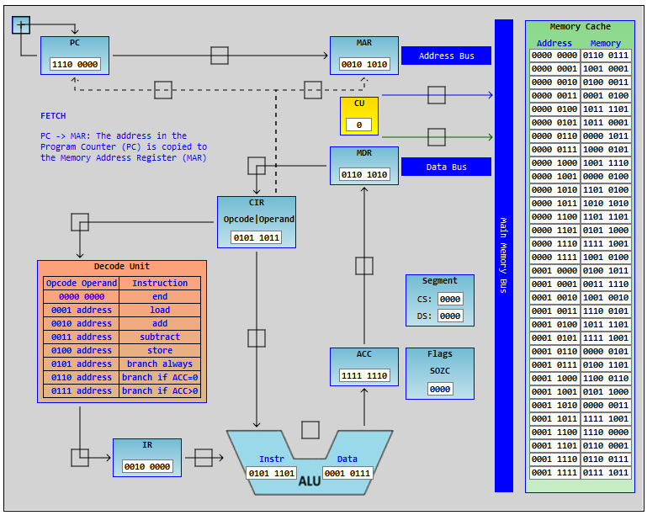
How is a program executed?
Loader – OS program
Loads instructions and data from secondary memory into primary memory and CPU Cache
Sets the address of the first instruction
Instruction Execution Cycle
Fetch – Load instructions from cache into CPU registers
Decode – Break object code instruction into CPU operation-codes
Execute – Perform arithmetic, logic, and data transfer operations

Slide 10


Slide 11
How would you describe the file format of a C/C++ source code file?
?

Slide 12
What tool do software developers use to write programs, and what features does the tool typically provide?
?

Slide 13
How do we classify programming language levels, and what level is C/C++?
?

Slide 14
What physical components of a computer make up primary vs secondary memory, and in which memory would we find a program at the development stage, executable stage, and running stage?
?

Slide 15
What are the four stages of the C/C++ build process and what does each do?
What file contents and formats make up the inputs/outputs of each stage?
?

Slide 16
What operating system tool is used when you execute a program and what two tasks does it perform?
What are the three steps of the instruction execution cycle?
?

